Slide 1
雲端計算
Cloud Computing
Storage Virtualization

Slide 2
Agenda
Storage Virtualization
  Introduction
  What to be virtualized
  Where to be virtualized
  How to be virtualized
  Case study

Slide 3
Storage Virtualization
Overview
What to be virtualized
Where to be virtualized
How to be virtualized
Case study

Slide 4
Overview
Introduction
What to be virtualized ?
  Block, File system
Where to be virtualized ?
  Host-based, Network-based, Storage-based
How to be virtualized ?
  In-band, Out-of-band
Case study
  Lustre, LVM

Slide 5
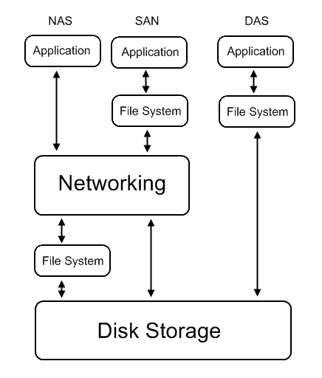
Storage Virtualization
Common storage architecture :
  DAS - Direct Attached Storage
    Storage device was directly attached to a server or workstation, without a storage network in between.
  NAS - Network Attached Storage
    File-level computer data storage connected to a computer network providing data access to heterogeneous clients.
  SAN - Storage Area Network
    Attach remote storage devices to servers in such a way that the devices appear as locally attached to the operating system.

Slide 6
Storage Virtualization
Desirable properties of storage virtualization:
  Manageability
    Storage resource should be easily configured and deployed.
  Availability
    Storage hardware failures should not affect the application.
  Scalability
    Storage resource can easily scale up and down.
  Security
    Storage resource should be securely isolated.

Slide 7
Storage Virtualization
Storage concept and technique
  Storage resource mapping table
  Redundant data
  Multi-path
  Data sharing
  Tiering

Slide 8
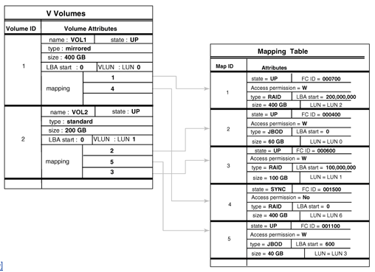
Concept and Technique
Storage resource mapping table
  Maintain tables to map storage resource to target.
  Dynamic modify table entries for thin provisioning.
  Use table to isolate different storage address space.

Slide 9
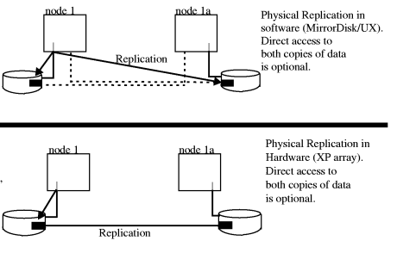
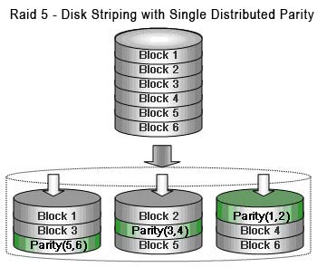
Concept and Technique
Redundant data
  Maintain replicas to provide high availability.
  Use RAID technique to improve performance and availability.

Slide 10
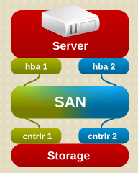
Concept and Technique
Multi-path
  A fault-tolerance and performance
  enhancement technique.
  There is more than one physical path
  between the host and storage devices
  through the buses, controllers,
  switches, and bridge devices
  connecting them.

Slide 11
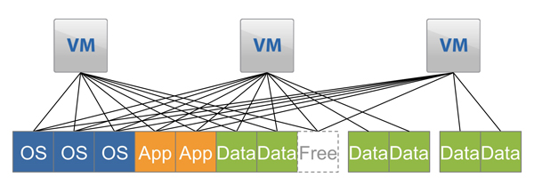
Concept and Technique
Data sharing
  Use data de-duplication technique to eliminate duplicated data.
  Saving and improving the usage of storage space

Slide 12
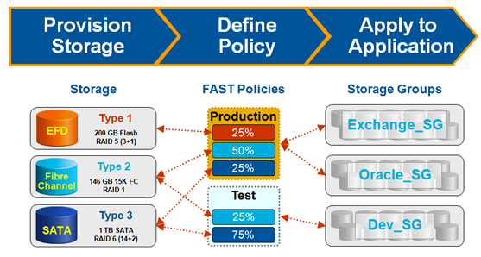
Concept and Technique
Tiering
  Automatic migrate data across storage resources with different properties according to the significance or access frequency of data.
Storage
Policies
Access Group

Slide 13
Storage virtualization
Overview
What to be virtualized
Where to be virtualized
How to be virtualized
Case study

Slide 14
What To Be Virtualized
Layers can be virtualized
  File system
    Provide compatible system call interface to user space applications.
  Block device
    Provide compatible block device interface to file system.
    Through the interface such as SCIS, SAS, ATA, SATA, etc.
User Space
Application
System call interface
Kernel Space
File System
Block interface
Device driver
Storage Device

Slide 15
File System Level
Data and Files
  What is data ?
    Data is information that has been converted to a machine-readable, digital binary format.
    Control information indicates how data should be processed.
    Applications may embed control information in user data for formatting or presentation.
    Data and its associated control information is organized into discrete units as files or records.
  What is file ?
    Files are the common containers for user data, application code, and operating system executables and parameters.

Slide 16
File System Level
About the files
  Metadata
    The control information for file management is known as metadata.
    File metadata includes file attributes and pointers to the location of file data content.
    File metadata may be segregated from a file's data content.
    Metadata on file ownership and permissions is used in file access.
    File timestamp metadata facilitates automated processes such as backup and life cycle management.
  Different file systems
    In Unix systems, file metadata is contained in the i-node structure.
    In Windows systems, file metadata is contained in records of file attributes.

Slide 17
File System Level
File system
  What is file system ?
    A file system is a software layer responsible for organizing and policing the creation, modification, and deletion of files.
    File systems provide a hierarchical organization of files into directories and subdirectories.
    The B-tree algorithm facilitates more rapid search and retrieval of files by name.
    File system integrity is maintained through duplication of master tables, change logs, and immediate writes off file changes.
  Different file systems
    In Unix, the super block contains information on the current state of the file system and its resources.
    In Windows NTFS, the master file table contains information on all file entries and status.

Slide 18
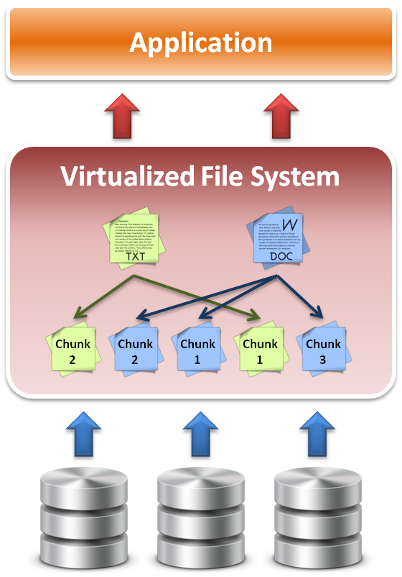
File System Level
File system level virtualization
  File system maintains metadata
  (i-node) of each file.
  Translate file access requests to underlining file system.
  Sometime divide large file into small sub-files (chunks) for parallel access, which improves the performance

Slide 19
Block Device Level
Block level data
  The file system block
    The atomic unit of file system management is the file system block.
    A file's data may span multiple file system blocks.
    A file system block is composed of a consecutive range of disk block addresses.
  Data in disk
    Disk drives read and write data to media through cylinder, head, and sector geometry.
    Microcode on a disk translates between disk block numbers and cylinder/head/sector locations.
    This translation is an elementary form of virtualization.

Slide 20
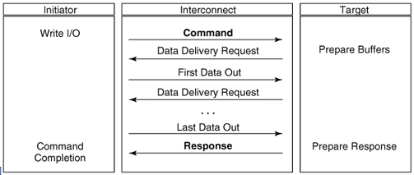
Block Device Level
Block device interface
  SCSI (Small Computer System Interface)
    The exchange of data blocks between the host system and storage is governed by the SCSI protocol.
    The SCSI protocol is implemented in a client/server model.
    The SCSI protocol is responsible for block exchange but does not define how data blocks will be placed on disk.
    Multiple instances of SCSI client/server sessions may run concurrently between a server and storage.

Slide 21
Block Device Level
Logical unit and Logical volume
  Logical unit
    The SCSI command processing entity within the storage target represents a logical unit (LU) and is assigned a logical unit number (LUN) for identification by the host platform.
    LUN assignment can be manipulated through LUN mapping, which substitutes virtual LUN numbers for actual ones.
  Logical volume
    A volume represents the storage capacity of one or more disk drives.
    Logical volume management may sit between the file system and the device drivers that control system I/O.
    Volume management is responsible for creating and maintaining metadata about storage capacity.
    Volumes are an archetypal form of storage virtualization.

Slide 22
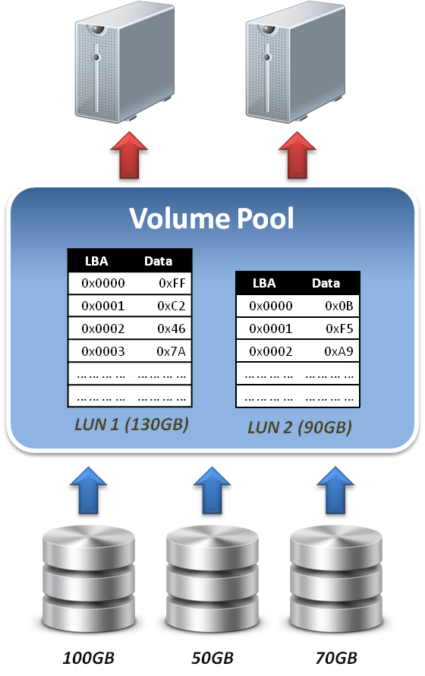
Block Device Level
Data block level virtualization
  LUN & LBA
    A single block of information is addressed using a logical unit identifier (LUN) and an offset within that LUN, which known as a Logical Block Address (LBA).
  Apply address space remapping
    The address space mapping is between a logical disk and a logical unit presented by one or more storage controllers.

Slide 23
Storage virtualization
Overview
What to be virtualized
Where to be virtualized
How to be virtualized
Case study

Slide 24
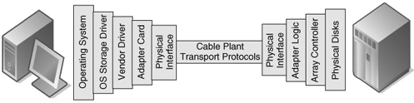
Where To Be Virtualized
Storage interconnection
  The path to storage
    The storage interconnect provides the data path between servers and storage.
    The storage interconnect is composed of both hardware and software components.
    Operating systems provide drivers for I/O to storage assets.
    Storage connectivity for hosts is provided by host bus adapters (HBAs) or network interface cards (NICs).

Slide 25
Where To Be Virtualized
Storage interconnection protocol
  Fibre Channel
    Usually for high performance requirements.
    Supports point-to-point, arbitrated loop, and fabric interconnects.
    Device discovery is provided by the simple name server (SNS).
    Fibre Channel fabrics are self-configuring via fabric protocols.
  iSCSI ( internet SCSI )
    For moderate performance requirements.
    Encapsulates SCSI commands, status and data in TCP/IP.
    Device discovery by the Internet Storage Name Service (iSNS).
    iSCSI servers can be integrated into Fibre Channel SANs through IP storage routers.

Slide 26
Where To Be Virtualized
Abstracting physical storage
  Physical to virtual
    The cylinder, head and sector geometry of individual disks is virtualized into logical block addresses (LBAs).
    For storage networks, the physical storage system is identified by a network address / LUN pair.
    Combining RAID and JBOD assets to create a virtualized mirror must accommodate performance differences.
  Metadata integrity
    Storage metadata integrity requires redundancy for failover or load balancing.
    Virtualization intelligence may need to interface with upper layer applications to ensure data consistency.

Slide 27
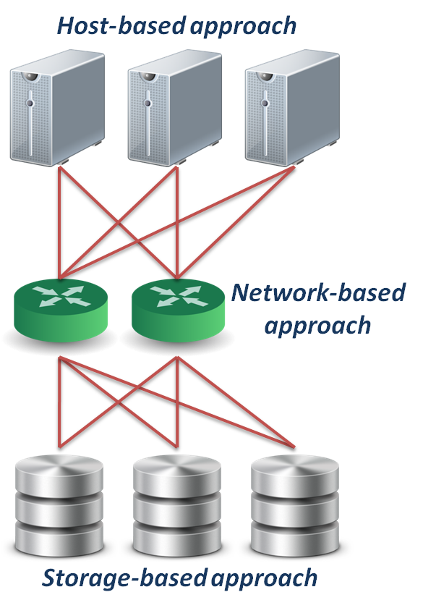
Where To Be Virtualized
Different approaches :
  Host-based approach
    Implemented as a software running on host systems.
  Network-based approach
    Implemented on network devices.
  Storage-based approach
    Implemented on storage target subsystem.

Slide 28


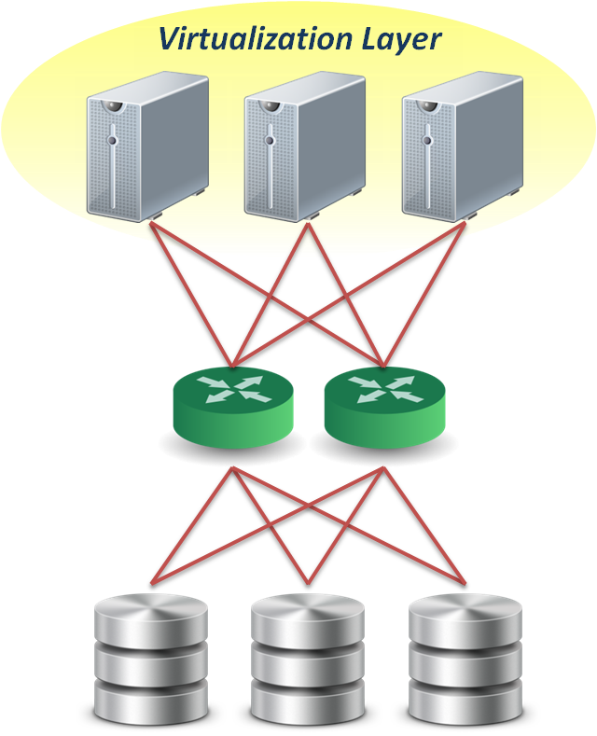
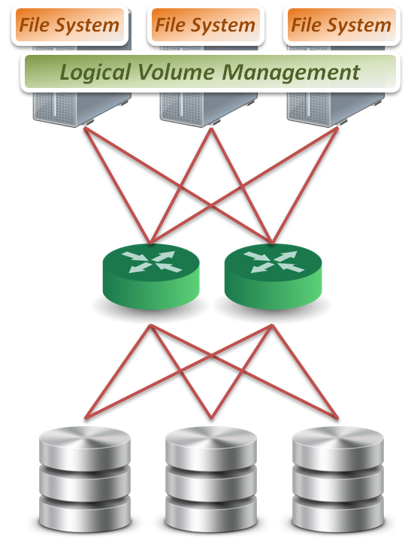
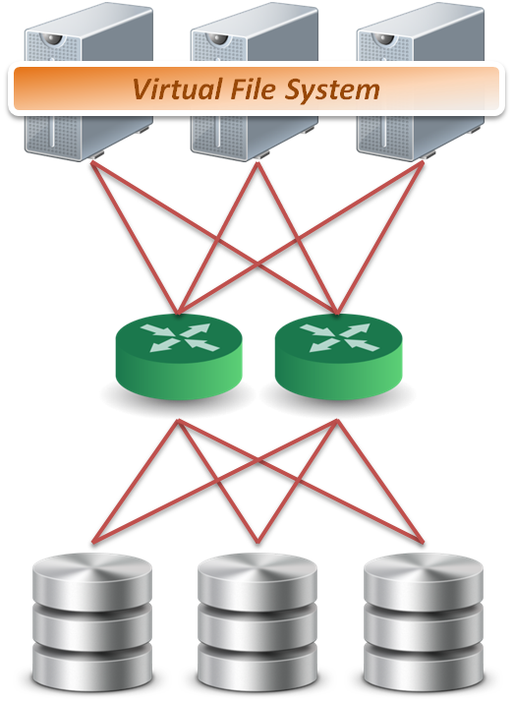

Host-based Virtualization
Host-based approach
  File level
    Run virtualized file system on the host to map files into data blocks, which distributed among several storage devices.
  Block level
    Run logical volume management software on the host to intercept I/O requests and redirect them to storage devices.
  Provide services
    Software RAID
Block 1
Block 2
Block 1
Block 2
Block 1
Sub-file
1
Sub-file
2
Sub-file
3

Slide 29
Host-based Virtualization
Important issues
  Storage metadata servers
    Storage metadata may be shared by multiple servers.
    Shared metadata enables a SAN file system view for multiple servers.
    Provides virtual to real logical block address mapping for client.
    A distributed SAN file system requires file locking mechanisms to preserve data integrity.
  Host-based storage APIs
    May be implemented by the operating system to provide a common interface to disparate virtualized resources.
    Microsoft's virtual disk service (VDS) provides a management interface for dynamic generation of virtualized storage.

Slide 30
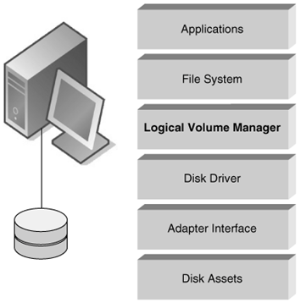
Host-based Virtualization
A typical example :
  LVM
    Software layer between the file system and the disk driver.
    Executed by the host CPU.
    Lack hardware-assist for functions such as software RAID.
    Independence from vendor-specific storage architectures.
    Dynamic capacity allocation to expand or shrink volumes.
    Support alternate pathing for high availability.

Slide 31
Host-based Virtualization
Host-based implementation
  Pros
    No additional hardware or infrastructure requirements
    Simple to design and implement
    Improve storage utilization
  Cons
    Storage utilization optimized only on a per host base
    Software implementation is depending on each operating system
    Consume CPU clock cycle for virtualization
  Examples
    LVM, NFS

Slide 32

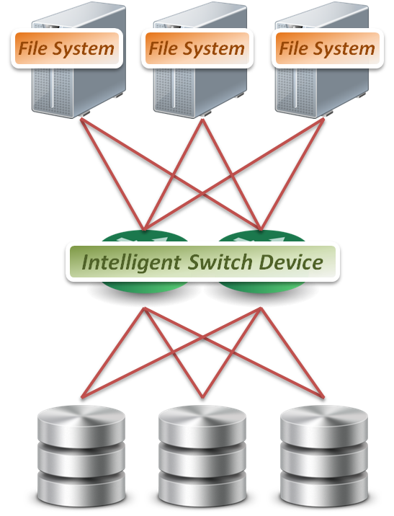
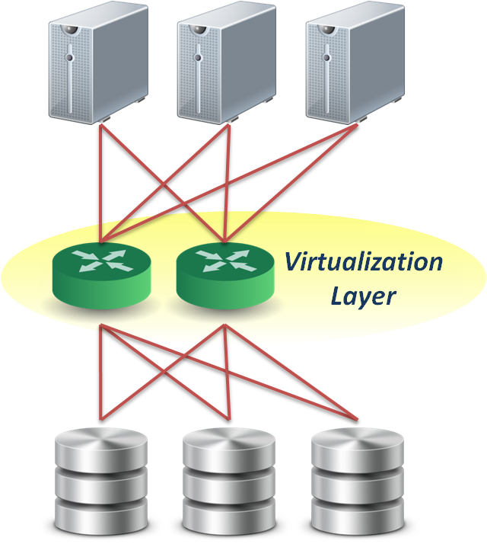
Network-based Virtualization
Network-based approach
  File level
    Seldom implement file level virtualization on network device.
  Block level
    Run software on dedicated appliances or intelligent switches and routers.
  Provide services
    Multi-path
    Storage pooling
Block 1
Block 2
Block 1
Block 2
Block 1

Slide 33
Network-based Virtualization
Requirements of storage network
  Intelligent services
    Logon services
    Simple name server
    Change notification
    Network address assignment
    Zoning
  Fabric switch should provide
    Connectivity for all storage transactions
    Interoperability between disparate servers,
    operating systems, and target devices

Slide 34
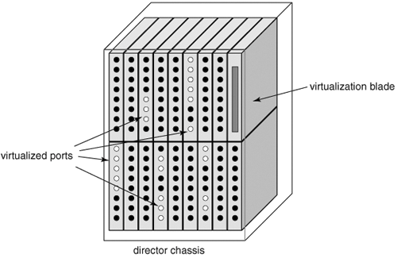
Network-based Virtualization
Techniques for fabric switch virtualization
  Hosted on departmental switches
    A PC engine provisioned as an option blade.
  Data center directors
    Should be able to preserve the five nines availability characteristic of director-class switches.
    Dedicated virtualization ASICs provide
    high-performance frame processing
    and block address mapping.
  Interoperability between
  different implementations
  will become a priority.

Slide 35
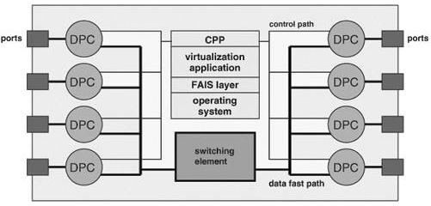
Network-based Virtualization
Interoperability issue
  FAIS ( Fabric Application Interface Standard )
    Define a set of standard APIs to integrate applications and switches.
    FAIS separates control information and data paths.
    The control path processor (CPP) supports the FAIS APIs and upper layer storage virtualization application.
    The data path controller (DPC) executes the virtualized SCSI I/Os under the management of one or more CPPs

Slide 36
Network-based Virtualization
Network-based implementation
  Pros
    True heterogeneous storage virtualization
    No need for modification of host or storage system
    Multi-path technique improve the access performance
  Cons
    Complex interoperability matrices - limited by vendors support
    Difficult to implement fast metadata updates in switch device
    Usually require to build specific network equipments (e.g., Fibre Channel)
  Examples
    IBM SVC ( SAN Volume Controller ), EMC Invista

Slide 37

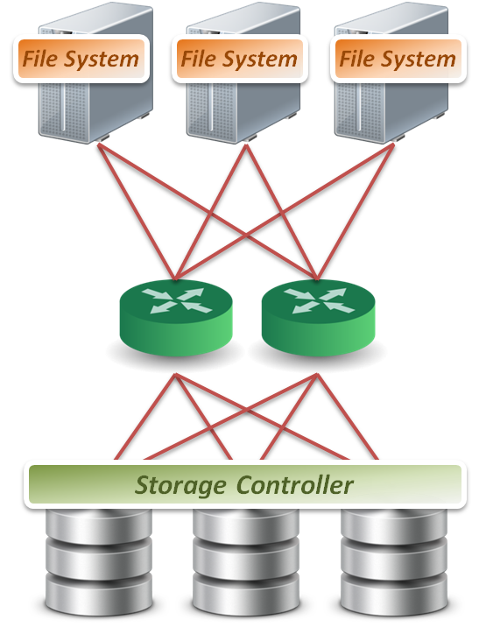
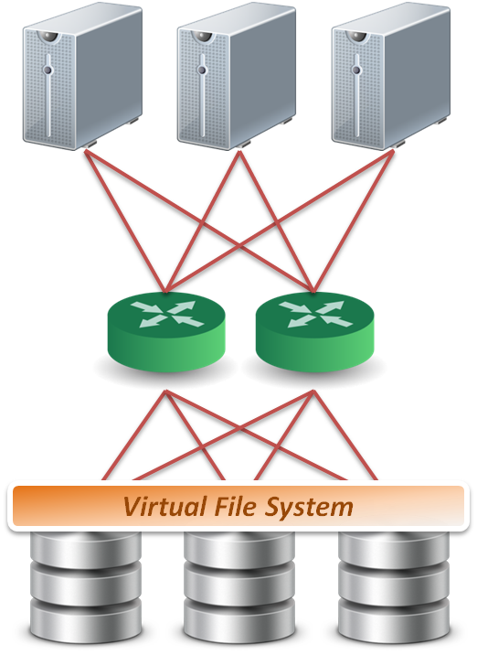
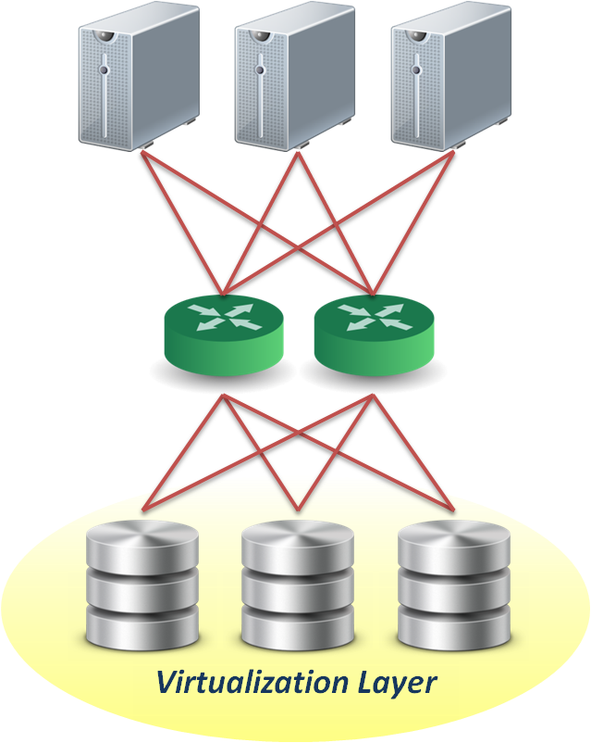
Storage-based Virtualization
Storage-based approach
  File level
    Run software on storage device to provide file based data storage services to host through network.
  Block level
    Embeds the technology in the target storage devices.
  Provide services
    Storage pooling
    Replication and RAID
    Data sharing and tiering
Block 1
Block 1
Block 1
Replica
Replica
Replica
Block 1
Block 1
Block 1
Sub-file
1
Sub-file
1.bak
Sub-file
2
Sub-file
2.bak
Sub-file
3

Slide 38
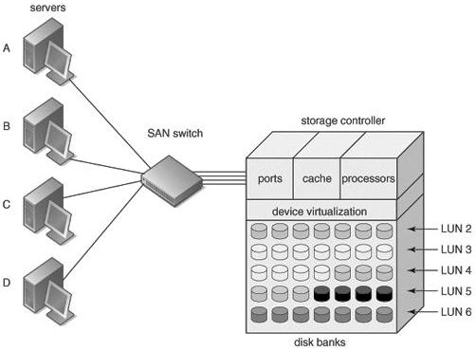
Storage-based Virtualization
Array-based virtualization
  Storage controller
    Provide basic disk virtualization in the form of RAID management, mirroring, and LUN mapping or masking.
    Allocate a single LUN to multiple servers.
    Offer Fibre Channel, iSCSI,
    and SCSI protocol.
  Cache memory
    Enhance performance.
  Storage assets coordination
    Coordination between
    multiple storage systems
    is necessary to ensure high
    availability.

Slide 39
Storage-based Virtualization
Data replication
  Array-based data replication
    Referred to as disk-to-disk replication.
    Requires that a storage controller function concurrently as both an initiator and target.
  Synchronous vs. Asynchronous
    Synchronous data replication ensures that a write operation to a secondary disk array is completed before the primary array acknowledges task completion to the server.
    Asynchronous data replication provides write completion by the primary array, although the transaction may still be pending to the secondary array.

Slide 40
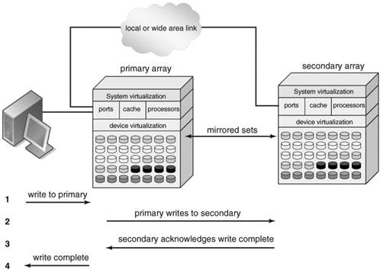
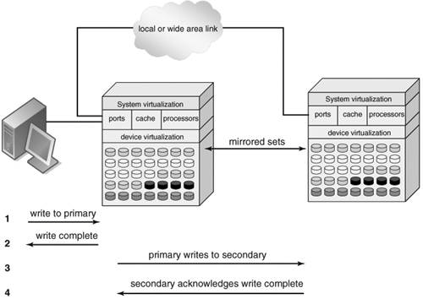
Storage-based Virtualization
Synchronous
Asynchronous
To preserve performance, synchronous data replication is limited to metropolitan distances
Asynchronous data replication is largely immune to transmission latency

Slide 41
Storage-based Virtualization
Other features
  Point-in-time copy ( snapshot )
    Provide point-in-time copies of an entire storage volume.
    Snapshot copies may be written to secondary storage arrays.
    Provide an efficient means to quickly recover a known good volume state in the event of data from the host.
  Distributed modular virtualization
    Decoupling storage controller logic from physical disk banks provides flexibility for supporting heterogeneous disk assets and facilitates distributed virtualization intelligence.
    Accommodates class of storage services and data lifecycle management.

Slide 42
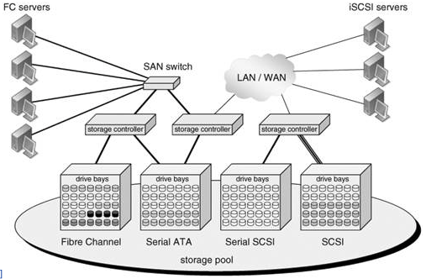
Storage-based Virtualization
Distributed Modular Virtualization
Decoupling storage controller intelligence and virtualization engines from physical disk banks facilitates multi-protocol block data access and accommodation of a broad range of disk architectures.

Slide 43
Storage-based Virtualization
Storage-based implementation
  Pros
    Provide most of the benefits of storage virtualization
    Reduce additional latency to individual IO
  Cons
    Storage utilization optimized only across the connected controllers
    Replication and data migration only possible across the connected controllers and the same vendors devices
  Examples
    Disk array products

Slide 44
Storage virtualization
Overview
What to be virtualized
Where to be virtualized
How to be virtualized
Case study

Slide 45
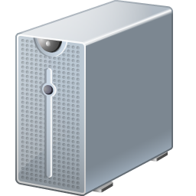

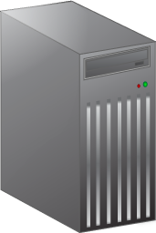

In-band Virtualization
Implementation methods :
  In-band
    Also known as symmetric, virtualization devices actually sit in the data path between the host and storage.
    Hosts perform IO to the virtualized device and never interact with the actual storage device.
  Pros
    Easy to implement
  Cons
    Bad scalability & Bottle neck
Control
Message
Control
Message
Control
Message
Control
Message
Control
Message
Control
Message
Data
Data
Data

Slide 46
Out-of-band Virtualization
Implementation methods :
  Out-of-band
    Also known as asymmetric, virtualization devices are sometimes called metadata servers.
    Require additional software in the host which knows the first request location of the actual data.
  Pros
    Scalability & Performance
  Cons
    Hard to implement
Control
Message
Control
Message
Control
Message
Control
Message
Control
Message
Control
Message
Data
Data
Data

Slide 47
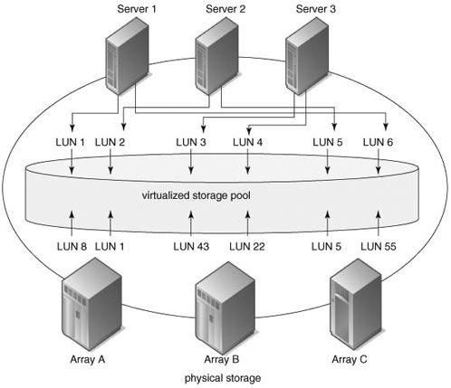
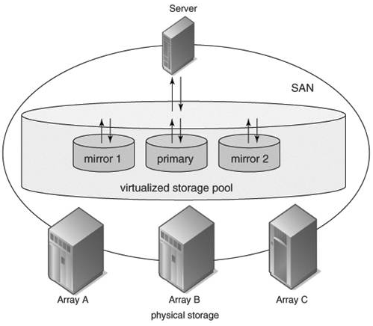
Other Virtualization Services
Pooling Heterogeneous
Storage Assets
Heterogeneous Mirroring
In a virtualized storage pool, virtual assets may be dynamically resized and allocated to servers by drawing on the total storage capacity of the SAN
Heterogeneous mirroring offers more flexible options than conventional mirroring, including three-way mirroring within storage capacity carved from different storage systems

Slide 48
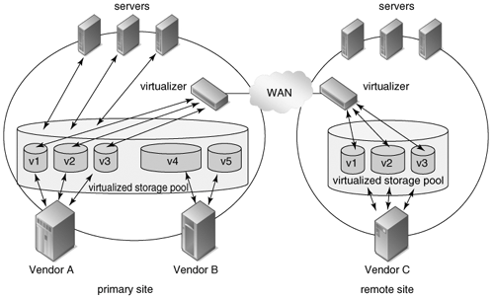
Other Virtualization Services
Heterogeneous Data Replication
Heterogeneous data replication enables duplication of storage data between otherwise incompatible storage systems.

Slide 49
Storage virtualization
Overview
What to be virtualized
Where to be virtualized
How to be virtualized
Case study

Slide 50


Case Study
Two cases
  Lustre
    Virtualized at file level
    Host-base virtualization approach
    Out-of-band virtualization
  LVM ( Logical Volume Management )
    Virtualized at block level
    Host-based virtualization approach
    In-band virtualization

Slide 51
Lustre File System
What is Lustre ?
  Lustre is a POSIX-compliant global, distributed, parallel filesystem.
  Lustre is licensed under GPL.
Some features :
  Parallel shared POSIX file system
  Scalable
    High performance
    Petabytes of storage
  Coherent
    Single namespace
    Strict concurrency control
  Heterogeneous networking
  High availability

Slide 52
Lustre File System
Lustre components :
  Metadata Server (MDS)
    The MDS server makes metadata stored in one or more MDTs.
  Metadata Target (MDT)
    The MDT stores metadata (such as filenames, permissions) on an MDS.
  Object Storage Servers (OSS)
    The OSS provides file I/O service, and network request handling for one or more local OSTs.
  Object Storage Target (OST)
    The OST stores file data as data objects on one or more OSSs.
Lustre network :
  Supports several network types
    Infiniband, TCP/IP on Ethernet, Myrinet, Quadrics, …etc.
  Take advantage of remote direct memory access (RDMA)
    Improve throughput and reduce CPU usage

Slide 53
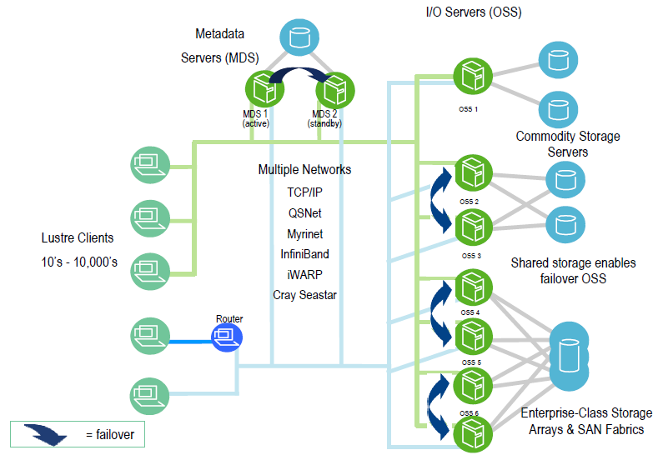
Lustre File System

Slide 54
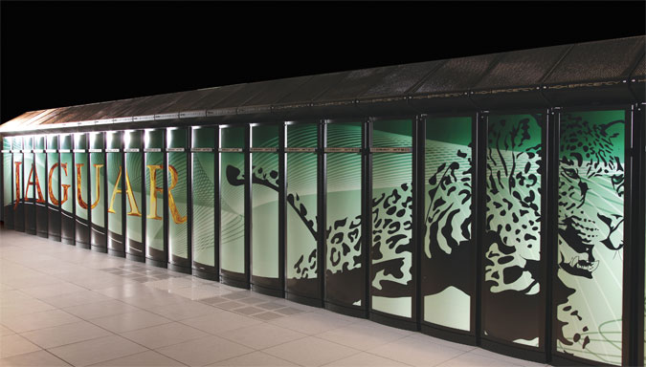
Lustre File System
Lustre in HPC
  Lustre is the leading HPC file system
    7 of Top 10
    Over 40% of Top100
    Demonstrated scalability
  Performance
    190 GB/sec IO
    26,000 clients
    Systems with over 1,000 nodes
  Examples
    Jaguar supercomputer at Oak Ridge National Laboratory
    System at Lawrence Livermore National Laboratory (LLNL)
    Texas Advanced Computing Center (TACC)

Slide 55
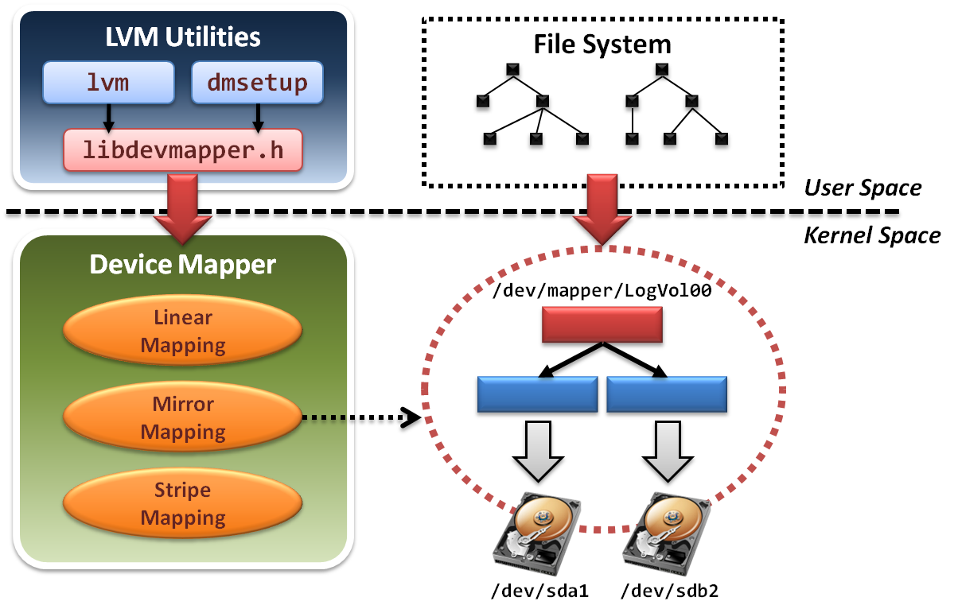
Logical Volume Management
LVM architecture

Slide 56
Logical Volume Management
LVM project is implemented in two components:
  In user space
    Some management utilities and configuration tools
    Ex. lvm , dmsetup
    Programming interface with a well-designed library
    Ex. libdevmapper.h
  In kernel space
    Implement device mapper framework
    Provide different mapped device targets
    Ex. linear , stripe , mirror …etc.

Slide 57
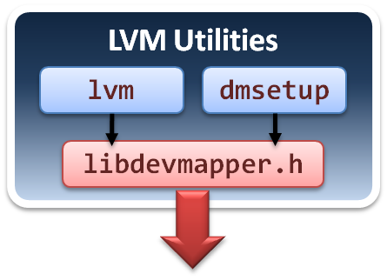
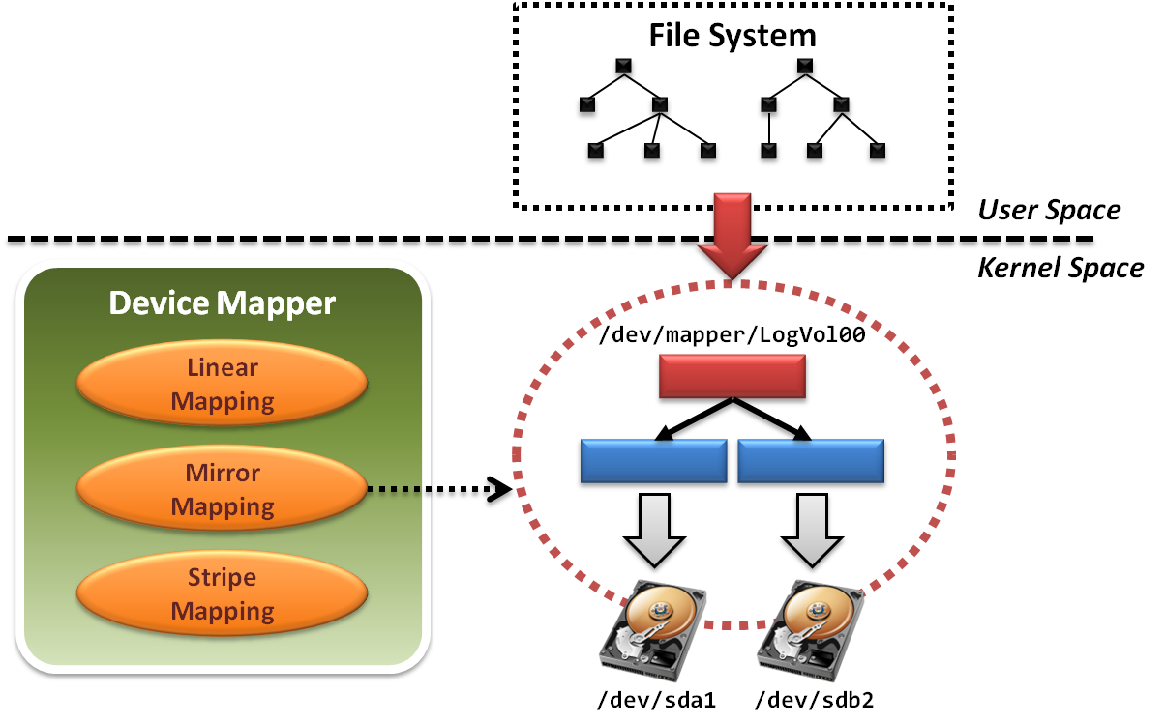
Logical Volume Management
Tools and utilities are in user space.

Slide 58
Logical Volume Management
lvm
  Command-line tools for LVM2.
    logical volume ( lv ) operations
    volume group ( vg ) operations
    physical volume ( pv ) operations
  Limited controllability
    Only can create logical volume with simple
    mapping mechanisms.
    Do not allow cross machine mappings.
dmsetup
  Limitations
    Still cannot provide cross machine mappings.

Slide 59
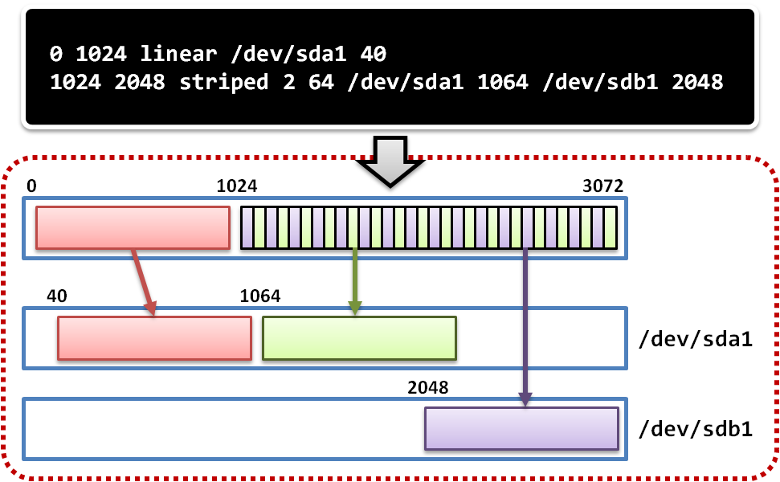
Logical Volume Management
dmsetup
  low level logical volume management
    Operate create, delete, suspend and resume …etc
    Work with mapping table file

Slide 60
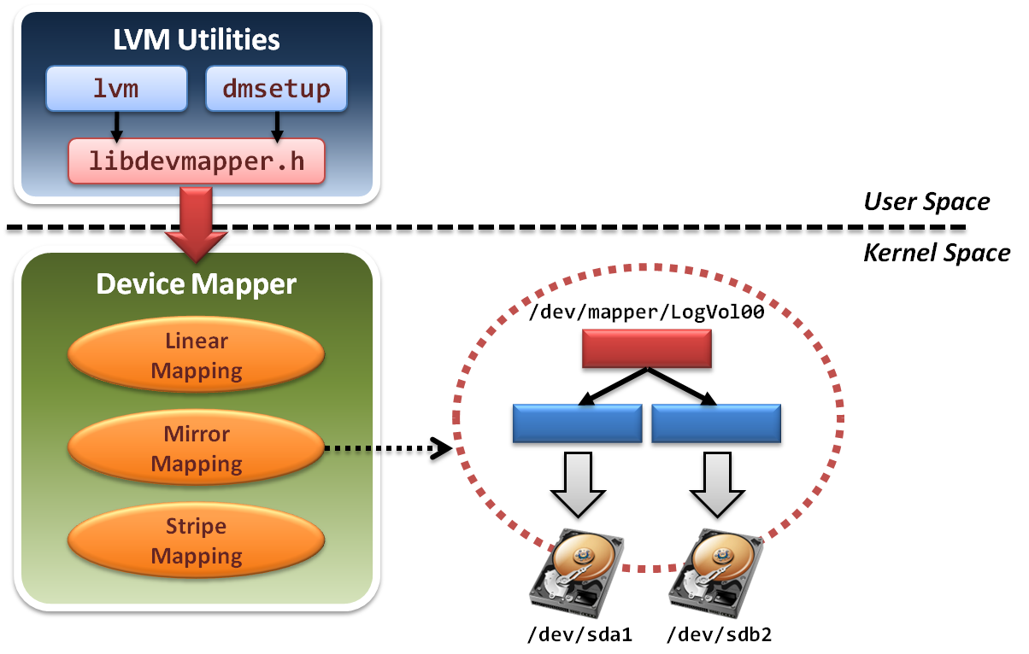
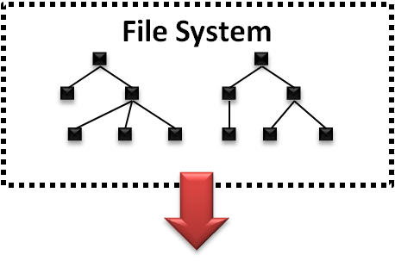
Logical Volume Management
File system will build upon device mapper framework by means of system calls.

Slide 61
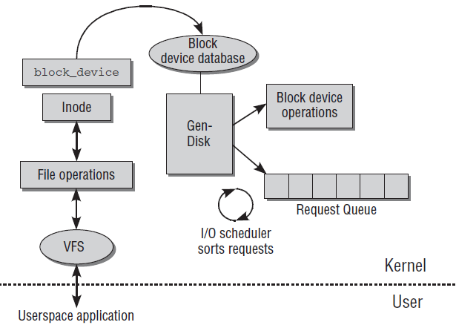
Logical Volume Management
File system in operating system will invoke a set of block device system calls.
Device Mapper framework
reload operation functions

Slide 62
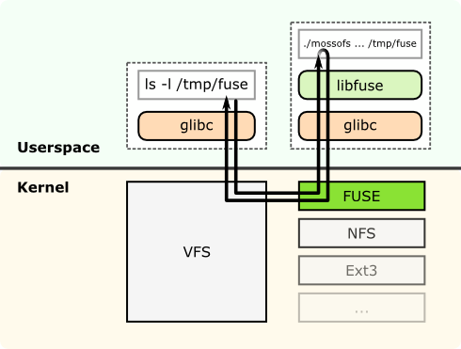
Logical Volume Management
File system can be also implemented in the user space only.

Slide 63
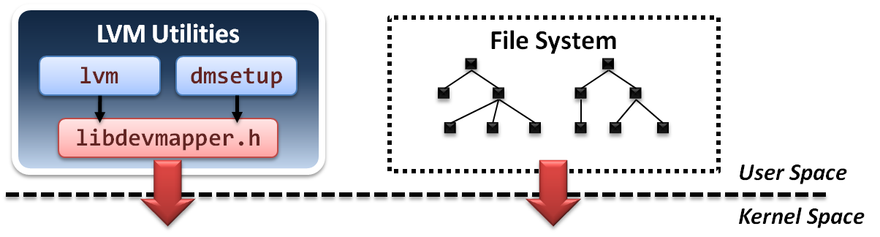
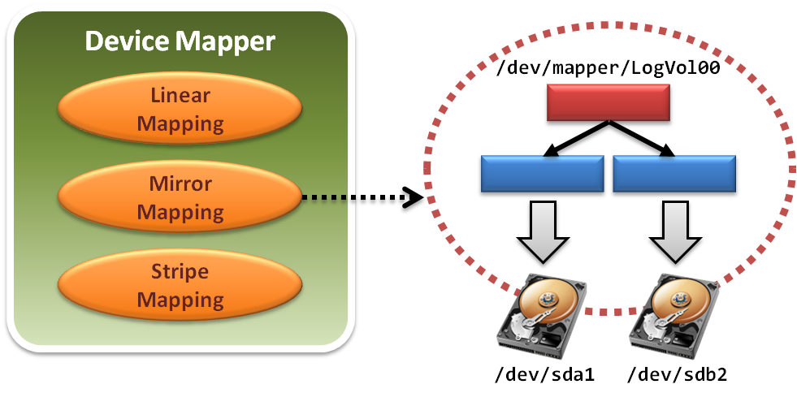
Logical Volume Management
Device mapper framework implements a Linux kernel driver for different mappings.

Slide 64
Logical Volume Management
Device mapper framework defines a set of target device mapping interfaces.
  dm_ctr_fn ctr
    Initiator of each newly created mapped device
  dm_dtr_fn dtr
    Destructor of each removing mapped device
  dm_map_fn map
    Setup the mapping relations
  dm_ioctl_fn ioctl
    Exactly perform system IO invocations
  … etc.

Slide 65
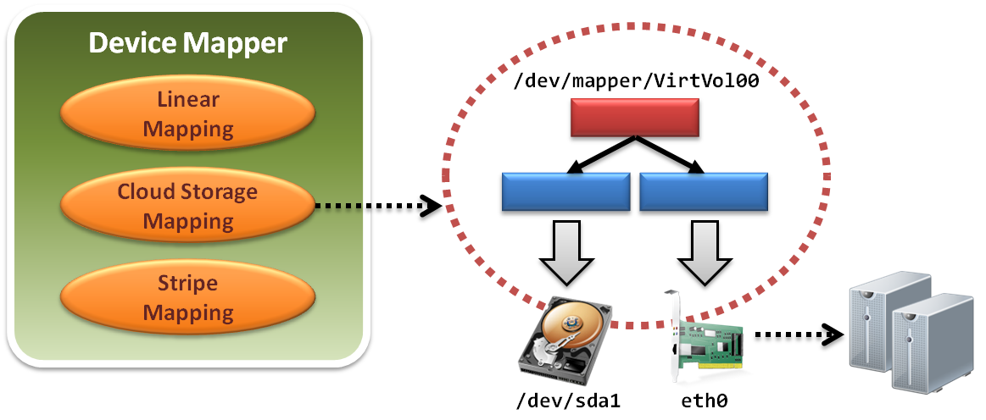
Logical Volume Management
Develop a new mapped device target and add it into device mapper framework.
  Improve scalability

Slide 66
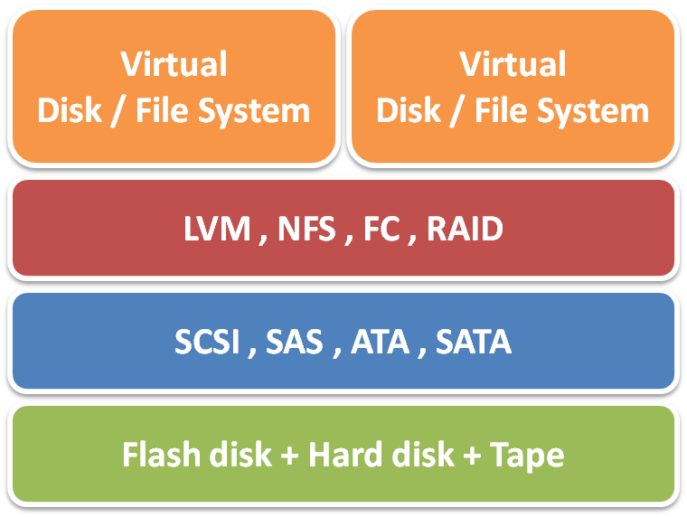
Summary
Storage virtualization technique :
  Virtualization layer
    File level and block level
  Virtualization location
    Host, network and storage base
  Virtualization method
    In-band and out-of-band
Storage virtualization services
  Storage pooling and sharing
  Data replication and mirroring
  Snapshot and multi-pathing
Case study
  Lustre filesystem, Logical Volume Management

Slide 67
References
Book:
  Tom Clark, Storage Virtualization: Technologies for Simplifying Data Storage and Management, Addison Wesley Professional, 2005.
Web resources:
  From Wikipedia, the free encyclopedia
  Lustre File System. http://www.oracle.com/us/products/servers-storage/storage/storage-software/031855.htm
  Logical Volume Management (LVM). http://www.tldp.org/HOWTO/LVM-HOWTO/

